Slide 1
Session 25 : Internet Feeders
Module 4.3 : Android

Slide 2
Learning Objectives
At the end of the session successful participants will be able to
Understand Internet feeders

Slide 3
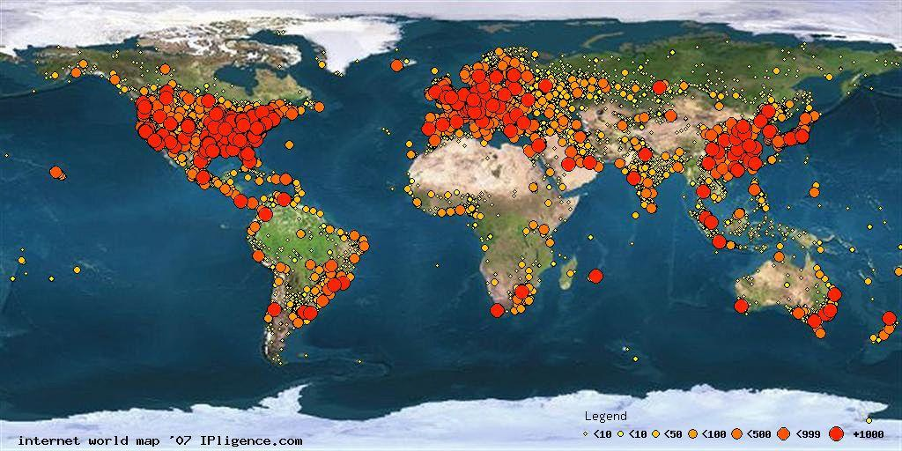
Internet Feeders
Communicating Via Internet
The image illustrates Year 2007 Internet Density. Colored dots represent number of IP addresses per dot-area.
Source: www.ipligence.com/worldmap/internet-map.jpg

Slide 4
Internet Feeders
Communicating Via Internet
2007 - Breakdown By Geographic Area
Geographic Area | Number of IP Addresses | Percentage
Africa | 40241664 | 1.519%
Antarctica | 15620 | 0.001%
Asia | 371297015 | 14.015%
Caribbean | 1681866 | 0.063%
Central America | 2557340 | 0.097%
Europe | 569838903 | 21.510%
Middle East | 12011131 | 0.453%
North America | 1481754661 | 55.932%
Oceania | 76417711 | 2.885%
South America | 93409304 | 3.525%

Slide 5
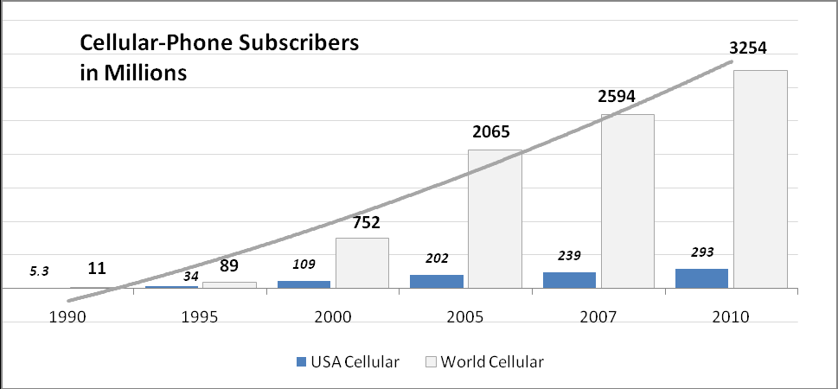
Internet Feeders
USA & Worldwide Growth Of Cellular Telephony

Slide 6
Internet Feeders
Study on Information & Communication Technology (ICT)
World Bank Organization 2009: Conclusion
Countries that have taken steps to create a competitive market environment for ICT generally have a larger share of people using ICT services than those that have not.
One important outcome of competition is that it lowers prices for ICT services.
But while prices are falling rapidly ICT services are still unaffordable for many people in low-income countries.

Slide 7
Internet Feeders
Study on Information & Communication Technology (ICT)
World Bank Organization 2009: Conclusion
As a result a large share of the population in these countries has yet to realize the potential of ICT for economic and social development.
Among ICT services voice communications particularly mobile telephony has led the way.
Access to new services such as broadband remains limited in developing countries.

Slide 8
Internet Feeders
Study on Information & Communication Technology (ICT)
World Bank Organization 2009: Conclusion
Yet the expansion of broadband networks plays a catalytic role in the development of trade and e-government.
In some developing countries trade in ICT goods and services has sparked export-led growth and job creation.
ICT applications are also transforming how governments deliver public services to citizens and businesses.

Slide 9
Internet Feeders
Background – Web Feeds
Web feeds allow (client) software programs to check for summary updates published on a website.
First version of RSS was created by Netscape around 1999.
A typical news feed (or channel) contains entries which may be:
headlines,
full-text articles excerpts,
summaries,
Thumbnails, and/or
links to content on a website along with various metadata

Slide 10
Internet Feeders
Background – Web Feeds
Web feeds allow (client) software programs to check for summary updates published on a website.
The Atom Syndication Format and RSS 2.0 are common XML standards used to organize, create and update web feeds (these formats have been adopted by Google, Yahoo!, Apple/iTunes, CNN, NY Times,…).

Slide 11
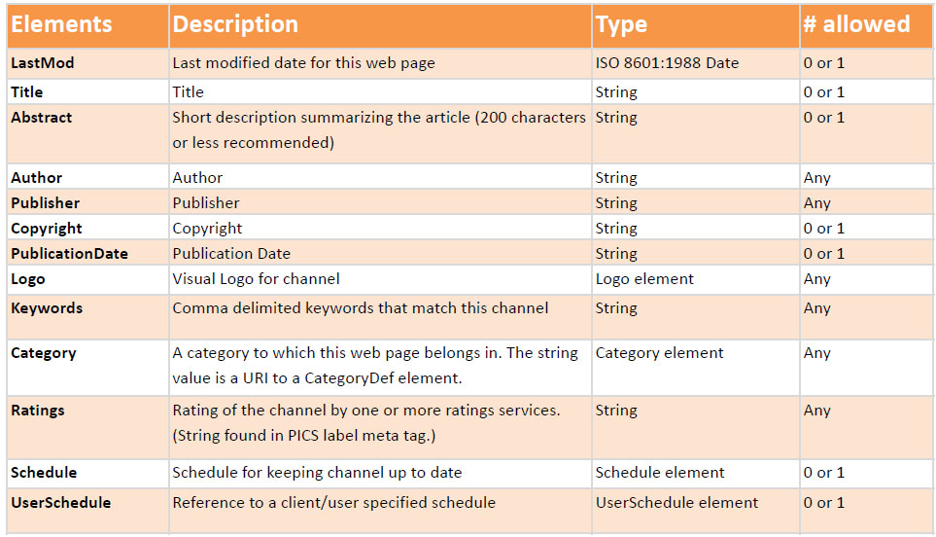
Internet Feeders
Background – Web Feeds
Common child elements of Channel and Item

Slide 12
Internet Feeders
Background – Web Feeds
Elements of <item>
A channel may contain any number of <item>s. An item may represent a "story" --much like a story in a newspaper or magazine.

Slide 13
Internet Feeders
Background – Web Feeds
Elements of <item>
Element | Description
title | The title of the item.
link | The URL of the item.
description | The item synopsis.
author | Email address of the author of the item.
category | Includes the item in one or more categories.
comments | URL of a page for comments relating to the item.
enclosure | Describes a media object that is attached to the item.
guid | A string that uniquely identifies the item.
pubDate | Indicates when the item was published.
source | The RSS channel that the item came from.

Slide 14
Internet Feeders
Background – Web Feeds
Example
<?xml version="1.0" encoding="UTF-8" ?>
<rssversion="2.0">
<channel>
<title>RSS Title</title>
<description>This is an example of an RSS feed</description>
<link>http://www.someexamplerssdomain.com/main.html</link>
<lastBuildDate>Mon, 06 Sep 2010 00:01:00 +0000 </lastBuildDate>
<pubDate>Mon, 06 Sep 2009 16:45:00 +0000 </pubDate>
<item>
<title>Example entry</title>
<description>Here is some text containing an interesting description of the thing to be described. </description>

Slide 15
Internet Feeders
Background – Web Feeds
Example
<link>http://www.wikipedia.org/</link>
<guid>unique string per item</guid>
<pubDate>Mon, 06 Sep 2009 16:45:00 +0000 </pubDate>
</item>
</channel>
</rss>

Slide 16

Internet Feeders
Background - RSS
RSS (most commonly translated as Really Simple Syndication but sometimes Rich Site Summary) is a family of web feed formats used to publish frequently updated works – such as…
Blog Entries
News Headlines
Weather Reports
Audio in standard format
Video in standard format

Slide 17

Internet Feeders
Background - RSS
An RSS document (which is called a web feedor channel) includes full or summarized text (plus metadata), publishing dates and authorship.
Content distributors expose web feeds allowing users to subscribe to them.
Making a collection of web feeds accessible in one spot is known as aggregation which is performed by an Internet aggregator.

Slide 18
Internet Feeders
Background – RSS Sources
US weather:
http://www.weather.gov/view/national.php?map=on
The Weather Channel
http://rss.weather.com/weather/rss/local/44114?cm_ven=LWO&cm_cat=rss&par=LWO_rss
World weather
http://www.rssweather.com/dir
News
http://www.npr.org/rss/
http://www.cnn.com/services/rss/
http://news.bbc.co.uk/2/hi/help/3223484.stm
http://www.nytimes.com/services/xml/rss/nyt/GlobalHome.xml

Slide 19
Internet Feeders
Background – RSS Sources
Money Exchange
http://themoneyconverter.com/RSSFeeds.aspx
Entertainment
http://www.nbclosangeles.com/rss/
http://www.movies.com/rss/
RSS Aggregator
http://www.rss-network.com/
http://www.nytimes.com/services/xml/rss/index.html
Corporate
http://www.toyota.co.jp/en/rss/rss-responsibility.html
http://home3.americanexpress.com/corp/rss/
http://www.aa.com/i18n/urls/rss.jsp

Slide 20
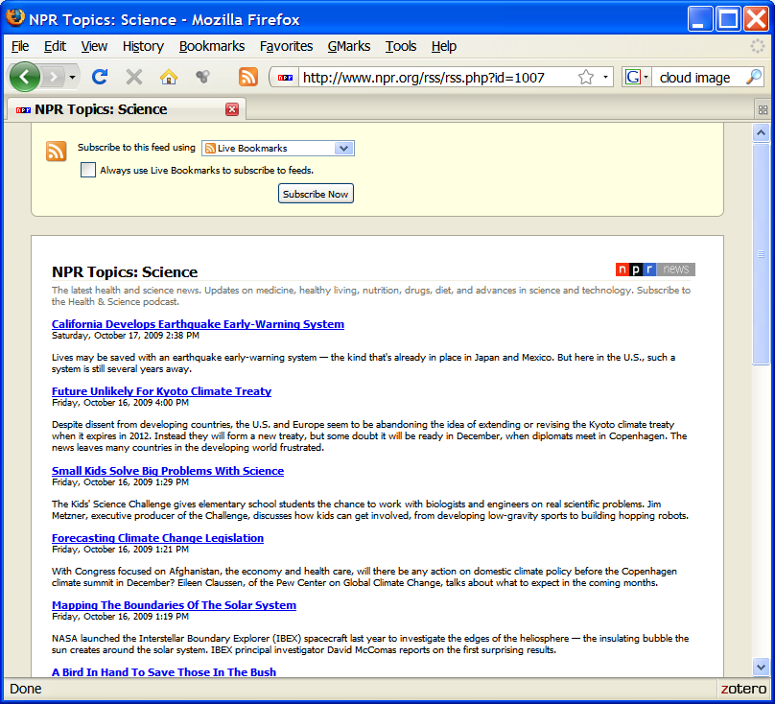
Internet Feeders
Background – RSS Sources
How do RSS feeds look like when using a browser?

Slide 21
Internet Feeders
Background – RSS Sources
XML Version of the NPR RSS Feed (Just a fragment)
<?xml version="1.0"?>
<?xml-stylesheet title="XSL_formatting" type="text/xsl" href="/include/xsl/rss.xsl"?>
<rss xmlns:npr="http://www.npr.org/rss/" xmlns:nprml="http://api.npr.org/nprml"
xmlns:itunes="http://www.itunes.com/dtds/podcast-1.0.dtd"
xmlns:content="http://purl.org/rss/1.0/modules/content/" version="2.0">
<channel>
<title>NPR Topics: Science</title>
<link>http://www.npr.org/templates/story/story.php?storyId=1007&amp;ft=1&amp;f=1007</link>

Slide 22
Internet Feeders
Background – RSS Sources
XML Version of the NPR RSS Feed (Just a fragment)
<description>The latest health and science news. Updates on medicine, healthy
living, nutrition, drugs, diet, and advances in science and technology.
Subscribe to the Health &amp; Science podcast.</description>
<copyright>Copyright 2009 NPR - For Personal Use Only</copyright>
<generator>NPR API RSS Generator 0.93</generator>
<lastBuildDate>Sat, 17 Oct 2009 14:38:00 -0400</lastBuildDate>
<image>
<url>http://media.npr.org/images/npr_news_123x20.gif</url>
<title>Science</title>

Slide 23
Internet Feeders
Background – RSS Sources
XML Version of the NPR RSS Feed (Just a fragment)
<link>http://www.npr.org/templates/story/story.php?storyId=1007&amp;ft=1&amp;f=1007</link>
</image>
<item>
<title>California Develops Earthquake Early-Warning System</title>
<description>Lives may be saved with an earthquake early-warning system &amp;mdash; the kind that's already in place in Japan and Mexico. But here in the U.S., such a system is still several years away.</description>
<pubDate>Sat, 17 Oct 2009 14:38:00 -0400</pubDate>

Slide 24
Internet Feeders
Background – RSS Sources
XML Version of the NPR RSS Feed (Just a fragment)
<link>http://www.npr.org/templates/story/story.php?storyId=113877510&amp;ft=1&amp;f=1007</link>
<guid>http://www.npr.org/templates/story/story.php?storyId=113877510&amp;ft=1&amp;f=1007</guid>
<content:encoded><![CDATA[<p>Lives may be saved with an earthquake early-warning system &mdash; the kind that's already in place in Japan and Mexico. But here in the U.S., such a system is still several years away.</p><p><a
href="http://www.npr.org/templates/email/emailAFriend.php?storyId=113877510">&raquo;

Slide 25
Internet Feeders
Background – RSS Sources
XML Version of the NPR RSS Feed (Just a fragment)
Add to Del.icio.us</a></p>]]></content:encoded>
</item>
Many <ITEM>s were intentionally removed to fit page size
<item>
<title>Mapping The Boundaries Of The Solar System</title>
<description>NASA launched the Interstellar Boundary Explorer (IBEX) spacecraft last year to investigate the edges of the heliosphere &amp;mdash; the insulating bubble the sun creates around the solar system. IBEX principal investigator David McComas reports on the first surprising results.</description>
E-Mail This</a>&nbsp;&nbsp;&nbsp;&nbsp; <a href="http://del.icio.us/post?url=

Slide 26
Internet Feeders
Background – RSS Sources
XML Version of the NPR RSS Feed (Just a fragment)
http%3A%2F%2Fwww.npr.org%2Ftemplates%2Fstory%2Fstory.php%3FstoryId%3D113877510">&raquo;
<pubDate>Fri, 16 Oct 2009 13:19:00 -0400</pubDate>
<link>http://www.npr.org/templates/story/story.php?storyId=113870291&amp;ft=1&amp;f=1007</link>
<guid>http://www.npr.org/templates/story/story.php?storyId=113870291&amp;ft=1&amp;f=1007</guid>
<content:encoded><![CDATA[<p>NASA launched the Interstellar Boundary Explorer (IBEX) spacecraft last year to investigate the edges of the heliosphere &mdash; the insulating bubble the sun creates around the solar system.
IBEX principal investigator David McComas reports on the first surprising results.</p>

Slide 27
Internet Feeders
Background – RSS Sources
XML Version of the NPR RSS Feed (Just a fragment)
<p><a href="http://www.npr.org/templates/email/emailAFriend.php?storyId=113870291">&raquo;
E-Mail This</a>&nbsp;&nbsp;&nbsp;&nbsp; <a href="http://del.icio.us/post?
url=http%3A%2F%2Fwww.npr.org%2Ftemplates%2Fstory%2Fstory.php
%3FstoryId%3D113870291">&raquo;
Add to Del.icio.us</a></p>]]></content:encoded>
</item>
Many <ITEM>s were intentionally removed to fit page size
</channel></rss>
<!-- Burned on demand at 2009-10-17 10:49:43-->
<!-- LIVE --> <!-- Burned 10/17/2009 10:49:43.407-->

Slide 28
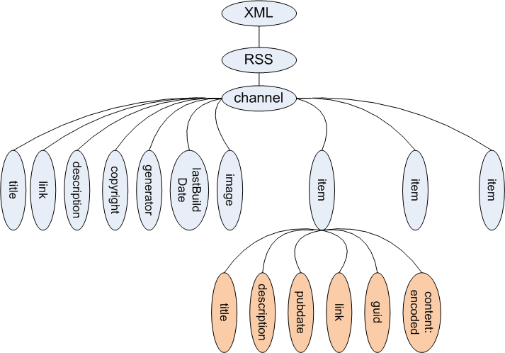
Internet Feeders
Representing The RSS XML As A Tree
The Android API includes a Document Builder Factory class to create this type of tree from an input stream

Slide 29
Internet Feeders
Document Object Model (DOM)
The Document Object Model (DOM) is an application programming interface API for valid HTML and well-formed XML documents.
With the Document Object Model, programmers can build documents, navigate their structure, and add, modify, or delete elements and content.
Android includes support for DOM managers.
DocumentBuilderFactorydbf = DocumentBuilderFactory.newInstance();
DocumentBuilderdb = dbf.newDocumentBuilder();
Document dom= db.parse(someHttpInputStream);

Slide 30
Internet Feeders
Android includes the Apache HttpComponents API
The HttpClient component (included in the API) facilitates building HTTP-aware client applications (such as web browsers and web services) using very small footprint .
GET
Requests a representation of the specified resource.
POST
Submits data to be processed to the identified resource.
HEAD
Same as GET but no message body.

Slide 31
Internet Feeders
Android includes the Apache HttpComponents API
The HttpClient component (included in the API) facilitates building HTTP-aware client applications (such as web browsers and web services) using very small footprint .
PUT
Uploads a representation of the specified resource.
DELETE
Deletes the specified resource.
TRACE
Echoes back the received request.

Slide 32
Internet Feeders
Android includes the Apache HttpComponents API
The HttpClient component (included in the API) facilitates building HTTP-aware client applications (such as web browsers and web services) using very small footprint .
OPTIONS
Returns the HTTP methods that the server supports for specified URL.
CONNECT
Converts the request connection to a transparent TCP/IP tunnel, usually to facilitate SSL-encrypted communication (HTTPS) through an unencrypted HTTP proxy.
Status Codes: Ok, Bad Request, Not Found, …

Slide 33
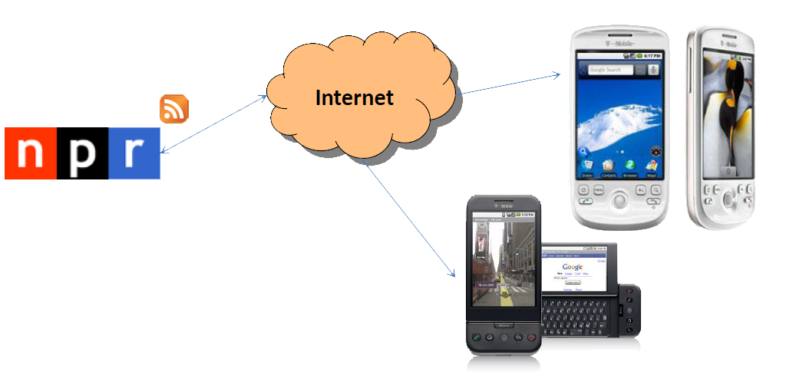
Internet Feeders
Putting All Things Together – An Example Application
In this project we will develop an application to expose the material typically broadcasted by National Public Radio(NPR) in Android phones.

Slide 34
Internet Feeders
NPR Project – Action Plan
A little research indicates that NPR supports a number of web feeds among them the following:
Topic | URL
Top Stories | http://www.npr.org/rss/rss.php?id=1001
U.S. News | http://www.npr.org/rss/rss.php?id=1003
World News | http://www.npr.org/rss/rss.php?id=1004
Business | http://www.npr.org/rss/rss.php?id=1006
Health & Science | http://www.npr.org/rss/rss.php?id=1007
Arts & Entertainment | http://www.npr.org/rss/rss.php?id=1008
Politics & Society | http://www.npr.org/rss/rss.php?id=1012
People & Places | http://www.npr.org/rss/rss.php?id=1021
Opinion | http://www.npr.org/rss/rss.php?id=1057

Slide 35
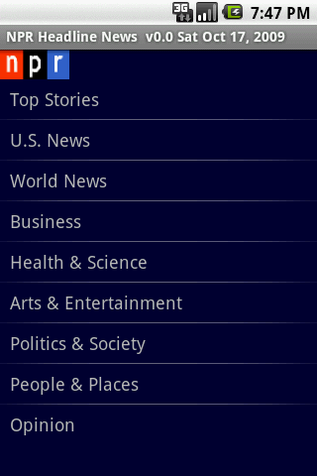
Internet Feeders
NPR Project – Action Plan
We will display the main topics in a ListView widget from which the user will make a selection. We use the associated web-feed to access the current contents of the selected category.

Slide 36
Internet Feeders
NPR Project – Action Plan
The most current headlines of the selected category are displayed. The User can scroll the list and click on a particular subject.
Observe that individual lines correspond to the XML <item> entries discussed earlier.
In the example we are interested in the
“Health & Science”. We want to know about the efforts of mapping the Solar System.

Slide 37
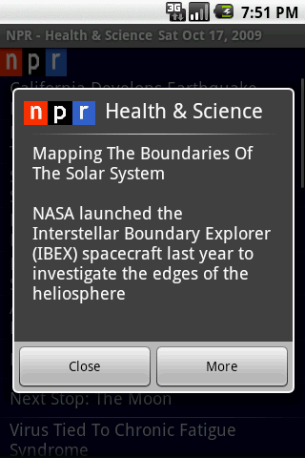
Internet Feeders
NPR Project – Action Plan
A brief summary of the chosen topic is displayed inside a DialogBox. The user is given the option of closing the window or obtaining more information.

Slide 38
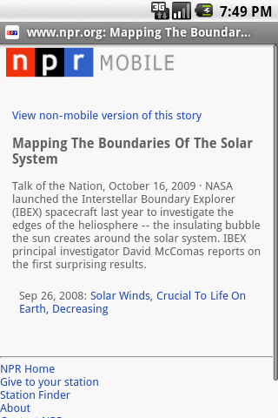
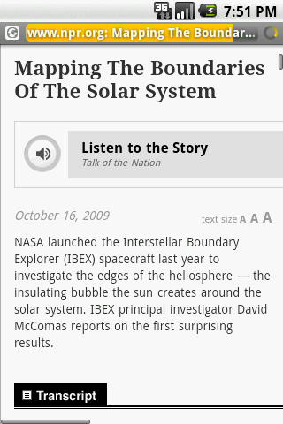
Internet Feeders
NPR Project – Action Plan
The link held in the XML <item> currently displayed is given to a WebKit based Activity. We use the Internet to access the page containing the detailed subject.
We may opt for a non-mobile page version which may include a number of additional components such as audio, pictures, video, extensive text, etc.

Slide 39
Internet Feeders
Acquiring & Processing The NPR Web-Feed
Assume the RSS for “Health & Science” is http://www.npr.org/rss/rss.php?id=1007.
The Java fragment in the next page uses the HttpComponents API.
The goal of this code is to grab the feed, and create a document holding the tree parsed from the XML document.

Slide 40
Internet Feeders
Acquiring & Processing The NPR Web-Feed
The tree will be traversed looking for <item> elements similar to those discussed earlier.
Each item will be dissected and the pieces arranged into a manageable object form. Remember an <item> includes among other components <title>, <description>, <link>, <datepublication>, etc.

Slide 41
Internet Feeders
Main Programming Idea
Acquiring & Processing The NPR Web-Feed
// connecting to the RSS provider
URL url = new URL(urlAddress);
URLConnection connection = url.openConnection();
HttpURLConnection httpConnection = (HttpURLConnection) connection;
int responseCode = httpConnection.getResponseCode();
if (responseCode == HttpURLConnection.HTTP_OK) {
// get RSS-XML and make a document
// holding the parse tree constructed from the input
}

Slide 42
Internet Feeders
Main Programming Idea
Acquiring & Processing The NPR Web-Feed
// setting & opening the connection using urlAddress which is
// a value such as: http://www.npr.org/rss/rss.php?id=1001
URL url = new URL(urlAddress);
URLConnection connection;
connection = url.openConnection();
HttpURLConnection httpConnection =
(HttpURLConnection) connection;
int responseCode = httpConnection.getResponseCode();
if (responseCode == HttpURLConnection.HTTP_OK) {
// get RSS-XML and make a document
// holding the parse tree constructed from the input}

Slide 43
Internet Feeders
Main Programming Idea
Acquiring & Processing The NPR Web-Feed
// USE httpConnection to get XML and make a document
// holding the parse tree constructed from the input
InputStream in = httpConnection.getInputStream();
// define a document builder to act on incoming stream
DocumentBuilderFactory dbf =
DocumentBuilderFactory.newInstance();
DocumentBuilder db = dbf.newDocumentBuilder();
// make XML parse tree for incoming RSS stream
Document dom = db.parse(in);
// define access nodes in the parse tree
Element docEle = dom.getDocumentElement();
// look for individual news ("items" in this case)

Slide 44
Internet Feeders
Main Programming Idea
Acquiring & Processing The NPR Web-Feed
// put items in a NodeList collection (nl)
NodeList nl = docEle.getElementsByTagName("item");
if ((nl != null) && (nl.getLength() > 0)) {
for (int i = 0; i < nl.getLength(); i++) {
dissectNode(nl, i);
}// for
}// if

Slide 45
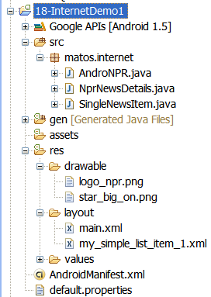
Internet Feeders
Main Programming Idea
NPR Project – Implementation
main.xml
<?xml version="1.0" encoding="utf-8"?>
<LinearLayout
android:id="@+id/widget28"
android:layout_width="fill_parent"
android:layout_height="fill_parent"
android:orientation="vertical"
android:background="#ff000033"
xmlns:android="http://schemas.android.com/apk/res/android”>

Slide 46
Internet Feeders
Main Programming Idea
NPR Project – Implementation
main.xml
<ImageView
android:layout_width="70px"
android:layout_height="30px"
android:layout_x="2px"
android:layout_y="2px"
android:background="@drawable/logo_npr">
>
</ImageView>

Slide 47
Internet Feeders
Main Programming Idea
NPR Project – Implementation
main.xml
<ListView
android:id="@+id/myListView"
android:layout_width="fill_parent"
android:layout_height="wrap_content"
>
</ListView>
</LinearLayout>

Slide 48
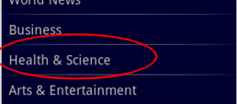
Internet Feeders
Main Programming Idea
NPR Project – Implementation
my_simple_list_item_1.xml
<?xml version="1.0" encoding="utf-8"?><TextViewxmlns:android=http://schemas.android.com/apk/res/android”
android:id="@android:id/text1“
android:layout_width="fill_parent“
android:layout_height="wrap_content“
android:gravity="center_vertical“
android:paddingLeft="10dip“
android:textSize="18sp" android:minHeight="40sp" />

Slide 49
Internet Feeders
Activity 1: AndroNPR.java
// display a list of main subjects for the user to choose a topic
package matos.internet;
import java.text.DateFormatSymbols;
import java.util.Calendar;
import java.util.Locale;
import android.app.Activity;
import android.content.Context;
import android.content.Intent;
import android.os.Bundle;
import android.view.View;
import android.widget.AdapterView;
import android.widget.ArrayAdapter;
import android.widget.ListView;

Slide 50
Internet Feeders
Activity 1: AndroNPR.java
import android.widget.AdapterView.OnItemClickListener;
Public class AndroNPR extends Activity {
ArrayAdapter<String> aa;
ListViewmyListView;
Context context;
SingleNewsItemselectedNewsItem;
String [] myUrlAddress= {
http://www.npr.org/rss/rss.php?id=1001,
http://www.npr.org/rss/rss.php?id=1003,
http://www.npr.org/rss/rss.php?id=1004,
http://www.npr.org/rss/rss.php?id=1006,
http://www.npr.org/rss/rss.php?id=1007,
http://www.npr.org/rss/rss.php?id=1008,
http://www.npr.org/rss/rss.php?id=1012,

Slide 51
Internet Feeders
Activity 1: AndroNPR.java
http://www.npr.org/rss/rss.php?id=1021,
http://www.npr.org/rss/rss.php?id=1057
};
String [] myUrlCaption= {
"Top Stories",
"U.S. News",
"World News",
"Business",
"Health & Science",
"Arts & Entertainment",
"Politics & Society",
"People & Places",
"Opinion"
};

Slide 52
Internet Feeders
Activity 1: AndroNPR.java
String [] myUrlAddress2= newString[myUrlAddressCaption.length];
String [] myUrlCaption2= newString[myUrlAddressCaption.length];
@Override
protected void onCreate(Bundle savedInstanceState) {
super.onCreate(savedInstanceState);
setContentView(R.layout.main);
context= getApplicationContext();
this.setTitle("NPR Headline News v0.0 "+ niceDate() );
myListView= (ListView)this.findViewById(R.id.myListView);

Slide 53
Internet Feeders
Activity 1: AndroNPR.java
myListView.setOnItemClickListener(newOnItemClickListener() {
publicvoidonItemClick(AdapterView<?> _av, View _v,
int_index, long_id) {
String urlAddress= myUrlAddress[_index];
String urlCaption= myUrlCaption[_index];
//create an Intent to talk to Activity2
Intent NprNewsDetailsIntent= newIntent(
AndroNPR.this, NprNewsDetails.class);
//prepare a Bundle and add the data pieces to be sent
Bundle myData= newBundle();
myData.putString("urlAddress", urlAddress);

Slide 54
Internet Feeders
Activity 1: AndroNPR.java
myData.putString("urlCaption", urlCaption);
NprNewsDetailsIntent.putExtras(myData);
startActivity(NprNewsDetailsIntent);
}});
//bind main category list (Top News, ...) to the thelistView
//show list and get ready for user to click on a category
intlayoutID= R.layout.my_simple_list_item_1;
aa= newArrayAdapter<String>(this, layoutID, myUrlCaption);
myListView.setAdapter(aa);
}//onCreate

Slide 55
Internet Feeders
Activity 1: AndroNPR.java
public static String niceDate() {
DateFormatSymbolsdfs= newDateFormatSymbols();
// to get short weekday-month_nameString arrays
String shortWeekdaysArray[] = dfs.getShortWeekdays();
String shortMonthArray[] = dfs.getShortMonths();
Calendar cal = Calendar.getInstance(Locale.US);
intdd= cal.get(Calendar.DAY_OF_MONTH);
intmm = cal.get(Calendar.MONTH);
String mmText= shortMonthArray[mm];
intyy= cal.get(Calendar.YEAR);

Slide 56
Internet Feeders
Activity 1: AndroNPR.java
intwd = cal.get(Calendar.DAY_OF_WEEK);
String wdText= shortWeekdaysArray[wd];
return( wdText+ " "+ mmText+ " "+ dd+ ", "+ yy);
}// niceDate
}// AndroNPR

Slide 57
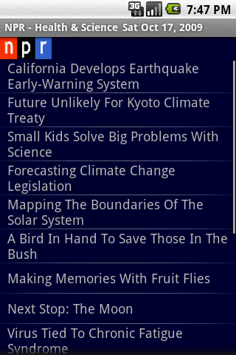
Internet Feeders
Activity 2: NPRNewsDetails.java
package matos.internet;
import java.io.IOException;
import java.io.InputStream;
import java.net.HttpURLConnection;
import java.net.MalformedURLException;
import java.net.URL;
import java.net.URLConnection;
import java.util.ArrayList;
import javax.xml.parsers.DocumentBuilder;
import javax.xml.parsers.DocumentBuilderFactory;
import javax.xml.parsers.ParserConfigurationException;
import org.w3c.dom.DOMException;
import org.w3c.dom.Document;

Slide 58
Internet Feeders
Activity 2: NPRNewsDetails.java
import org.w3c.dom.Element;
import org.w3c.dom.NodeList;
import org.xml.sax.SAXException;
import android.app.Activity;
import android.app.AlertDialog;
import android.content.Context;
import android.content.DialogInterface;
import android.content.Intent;
import android.content.DialogInterface.OnClickListener;
import android.net.Uri;
import android.os.Bundle;
import android.view.View;
import android.widget.AdapterView;

Slide 59
Internet Feeders
Activity 2: NPRNewsDetails.java
Import android.widget.ArrayAdapter;
Import android.widget.ListView;
Import android.widget.Toast;
Import android.widget.AdapterView.OnItemClickListener;
Public class NprNewsDetails extends Activity {
//a main category subject has already been selected by the user
//(data <"urlCaption", "urlAddress"> comes in a bundle sent
// by main, access web-feed and show corresponding headlines

Slide 60
Internet Feeders
Activity 2: NPRNewsDetails.java
ArrayList<SingleNewsItem> newsList= newArrayList<SingleNewsItem>();
ArrayAdapter<String> aa;
ListViewmyListView;
String urlAddress= "";
String urlCaption= "";
SingleNewsItemselectedNewsItem;
Context context= getApplication();
@Override
public void onCreate(Bundle savedInstanceState) {
super.onCreate(savedInstanceState);
setContentView(R.layout.main);

Slide 61
Internet Feeders
Activity 2: NPRNewsDetails.java
myListView= (ListView)this.findViewById(R.id.myListView);
//create a local Intent handler (needed to process input parameters)
Intent myLocalIntent= getIntent();
//grab the data bundle with all the pieces sent to us
//it contains 1. url-address and 2. caption-text
Bundle myBundle= myLocalIntent.getExtras();
urlAddress= myBundle.getString("urlAddress");
urlCaption= myBundle.getString("urlCaption");

Slide 62
Internet Feeders
Activity 2: NPRNewsDetails.java
//top caption for this screen
String todayStr= AndroNPR.niceDate();
this.setTitle("NPR -"+ urlCaption+ " \t"+ todayStr);
//clicking a line shows more about selected news item
myListView= (ListView)this.findViewById(R.id.myListView);
myListView.setOnItemClickListener(newOnItemClickListener() {
publicvoidonItemClick(AdapterView<?> _av, View _v,
int_index, long_id) {
selectedNewsItem= newsList.get(_index);

Slide 63
Internet Feeders
Activity 2: NPRNewsDetails.java
showNiceDialogBox(selectedNewsItem, context);
}
});
}//onCreate
@Override
protected void onResume() {
super.onResume();
Try{URL url= newURL(urlAddress);
URLConnectionconnection;
connection = url.openConnection();
HttpURLConnectionhttpConnection= (HttpURLConnection) connection;
intresponseCode= httpConnection.getResponseCode();

Slide 64
Internet Feeders
Activity 2: NPRNewsDetails.java
if(responseCode== HttpURLConnection.HTTP_OK) {
InputStreamin = httpConnection.getInputStream();
DocumentBuilderFactorydbf = DocumentBuilderFactory.newInstance();
DocumentBuilderdb = dbf.newDocumentBuilder();
Document dom= db.parse(in);
Element docEle= dom.getDocumentElement();
// NodeListnl= docEle.getElementsByTagName("entry");
NodeListnl= docEle.getElementsByTagName("item");

Slide 65
Internet Feeders
Activity 2: NPRNewsDetails.java
if((nl!= null) && (nl.getLength() > 0)) {
for(inti= 0; i< nl.getLength(); i++) {
dissectNode(nl, i);
}// for
}// if
}// if
intlayoutID= R.layout.my_simple_list_item_1;
ArrayAdapter<SingleNewsItem> aaNews=
newArrayAdapter<SingleNewsItem>(this, layoutID, newsList);
myListView.setAdapter(aaNews);
} catch(MalformedURLExceptione) {
e.printStackTrace();
}

Slide 66
Internet Feeders
Activity 2: NPRNewsDetails.java
catch(IOExceptione) {
e.printStackTrace();
Toast.makeText(context, "Trouble!!!", 1).show();
} catch(ParserConfigurationExceptione) {
e.printStackTrace();
} catch(SAXExceptione) {
e.printStackTrace();
}
}// onResume
publicvoiddissectNode(NodeListnl, inti){
try{
Element entry = (Element) nl.item(i);

Slide 67
Internet Feeders
Activity 2: NPRNewsDetails.java
Element title = (Element) entry.getElementsByTagName(
"title").item(0);
Element description = (Element) entry.getElementsByTagName(
"description").item(0);
Element pubDate= (Element) entry.getElementsByTagName(
"pubDate").item(0);
Element link = (Element) entry.getElementsByTagName(
"link").item(0);
String titleValue= title.getFirstChild().getNodeValue();

Slide 68
Internet Feeders
Activity 2: NPRNewsDetails.java
String descriptionValue=description.getFirstChild().getNodeValue();
String dateValue= pubDate.getFirstChild().getNodeValue();
String linkValue= link.getFirstChild().getNodeValue();
SingleNewsItemsingleItem= newSingleNewsItem(
dateValue,titleValue,descriptionValue, linkValue);
newsList.add(singleItem);
} catch(DOMExceptione) {
e.printStackTrace();
}}//dissectNode

Slide 69
Internet Feeders
Activity 2: NPRNewsDetails.java
Public void showNiceDialogBox(SingleNewsItemselectedNewsItem, Context context){
//assemble a nice looking dialog box
try{
finalUri myLink= Uri.parse(selectedNewsItem.getLink());
AlertDialog.BuildermyBuilder= newAlertDialog.Builder(this);
myBuilder
.setIcon(R.drawable.logo_npr)
.setTitle(urlCaption)
.setMessage( selectedNewsItem.getTitle() + "\n\n"
+ selectedNewsItem.getDescription() + "\n“).setPositiveButton("Close", null)

Slide 70
Internet Feeders
Activity 2: NPRNewsDetails.java
.setNegativeButton("More", newOnClickListener() {
public void onClick(DialogInterfacedialog, intwhichOne) {
// use native web browsing
Intent webIntent= newIntent( Intent.ACTION_VIEW, myLink);
startActivity(webIntent);
}
})//setNegativeButton
.show();
} catch(Exception e) {
e.printStackTrace();
}}//showNiceDialogBox
}//NprNewsDetails

Slide 71
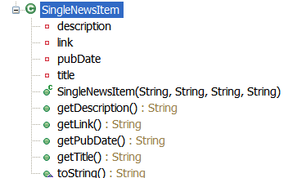
Internet Feeders
Class: SingleNewsItem.java
package matos.internet;
public class SingleNewsItem{
private String pubDate;
private String title;
private String description;
private String link;
public String getPubDate() { return pubDate; }
public String getTitle() { returntitle;}
public String getDescription(){ returndescription; }
public String getLink() { returnlink; }
public SingleNewsItem( String _pubDate, String _title, String _description,

Slide 72
Internet Feeders
Class: SingleNewsItem.java
String _link) {
pubDate= _pubDate;
description= _description;
title= _title;
link= _link;
}
@Override
publicString toString() {
returntitle;
}
}

Slide 73
Internet Feeders
manifest
<?xml version="1.0" encoding="utf-8"?>
<manifest xmlns:android="http://schemas.android.com/apk/res/android"
package="matos.internet"
android:versionCode="1"
android:versionName="1.0.0">
<application android:icon="@drawable/star_big_on" android:label="@string/app_name">
<activity android:name=".AndroNPR"
android:label="@string/app_name">
<intent-filter>
<action android:name="android.intent.action.MAIN" />
<category android:name="android.intent.category.LAUNCHER" />
</intent-filter>
</activity>

Slide 74
Internet Feeders
manifest
<activity android:name=".NprNewsDetails" >
</activity>
</application>
<uses-permission android:name="android.permission.INTERNET"/><uses-sdkandroid:minSdkVersion="4" />
</manifest>

